Slide 1
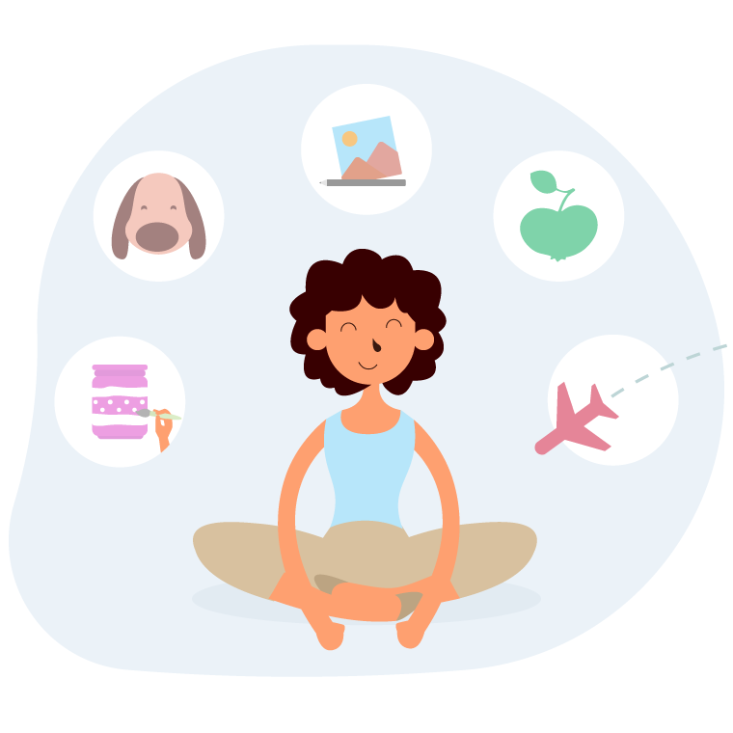
Presentation about myself
By Afrah Inayat
ERP 23984
Class code 5563

Slide 2
Contents
About myself
Basic education
Achievements and milestones
Goals In life
Inspirations
Favorite songs
Places I have Visited
Hobbies
My motto of life
Favorite movies and shows

Slide 3

About Myself
My name is Afrah Inayat. I was born on Thursday, 24th October 2002. I don’t remember much of my early childhood but my mom said that I was a very active and curious child. My earliest memory is me pulling my twin’s hair for she took my favorite toy. I am currently doing BBA from Institute of Business Administration.

Slide 4
Basic Education
Completetd Olevels from Jaffar Public School
Completed Alevels from Alpha College
Started BBA from Institute of Business Adminsitration
2019
2021
2021
Education helps develop human personality, thoughts, and prepares people for life experiences.

Slide 5




Achievements and milestones
Represented Jaffar Public School in Spelling Bee Compeition
Black Belt in Taekwondo
Share the awards and recognition awarded to him/her.
9th Position in Inter School Scrabble Championship organized by PSA
Member of student council in Alpha College

Slide 6
Goals in life
2024
Learn 2 new languages
2025
Complete BBA from Institute of Business Administration
2027
Start an organisation solely led by Women.
Setting goals helps trigger new behaviors and helps you sustain that momentum in life. Setting goals not only motivates us, but can also improve our mental health and our level of personal and professional success.

Slide 7
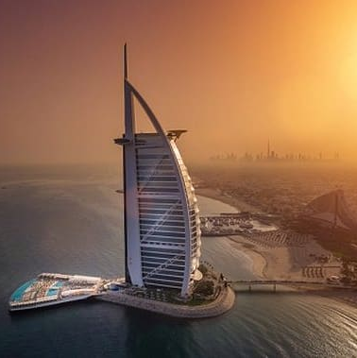
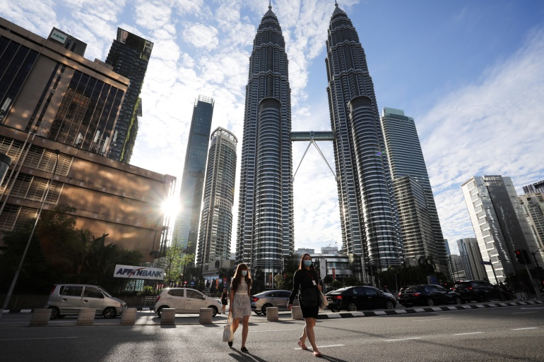
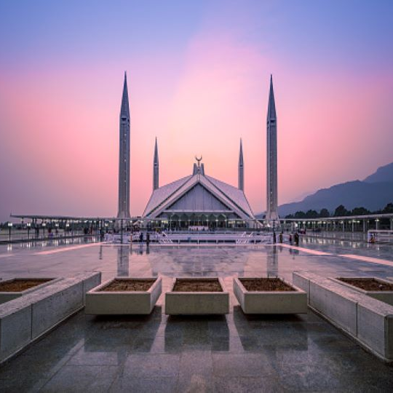
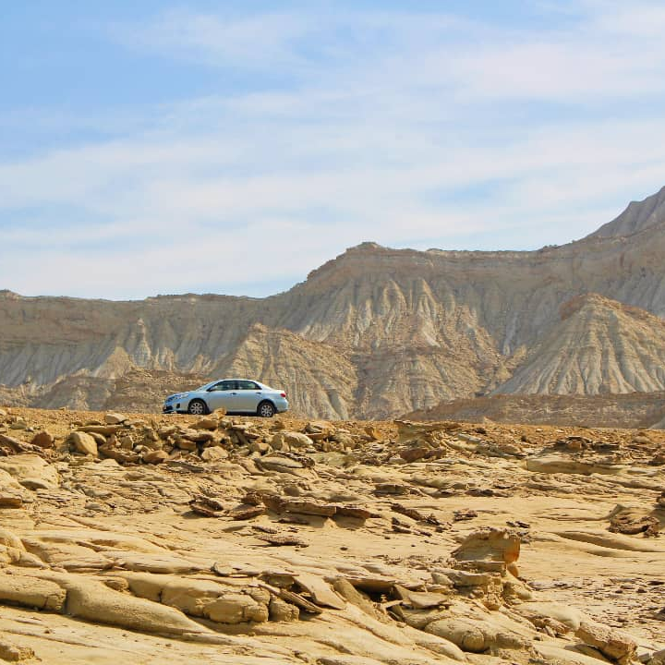
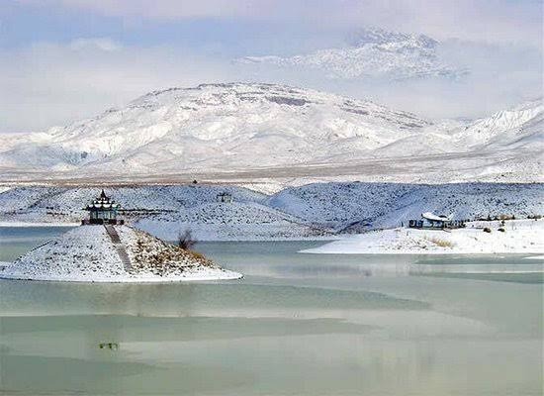
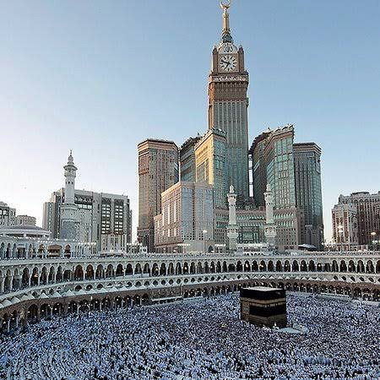
Places I have visited
Burj Al Arab, UAE
Petronus Tower, Malaysia
Faisal Mosque, Islamabd
Travel takes us out of our comfort zones and inspires us to see, taste and try new things
Hingol National Park, Balochistan
Hanna Jheel, Quetta
Makkah, Saudia Arabia

Slide 8
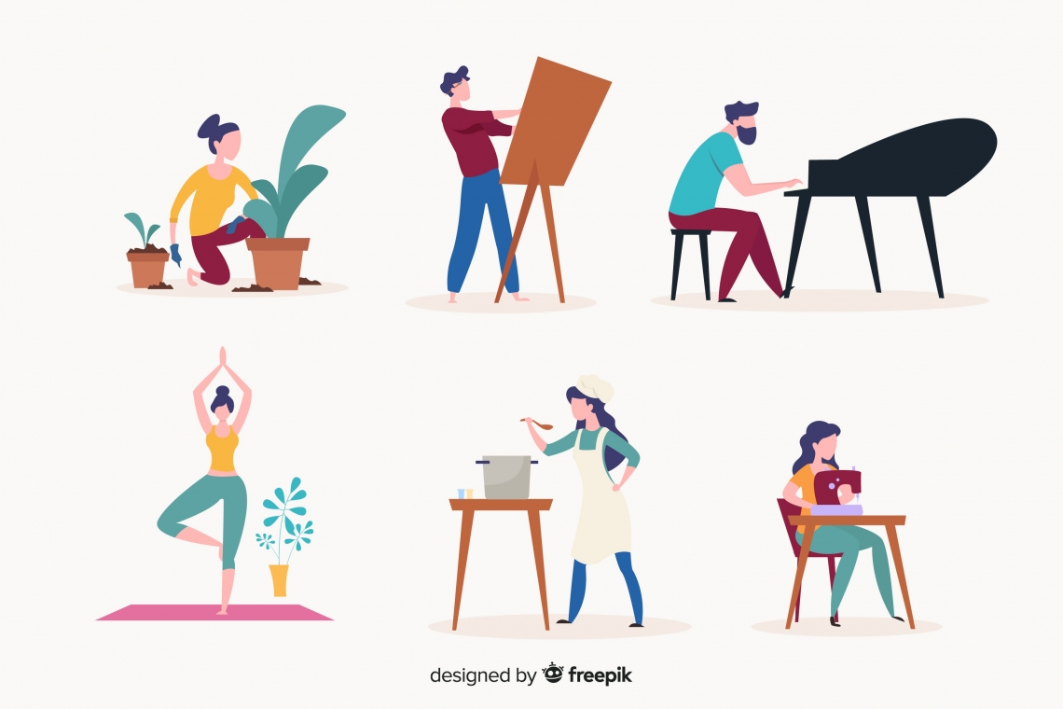
Hobbies
Hobbies allow you to keep yourself busy while remaining mentally productive. Enjoying a few hours of your hobby a week can improve your mental health. My hobbies include:
Free lancing
Reading
Article Writing
Sketching
Baking
Hobbies give you an opportunity to enhance your life.

Slide 9
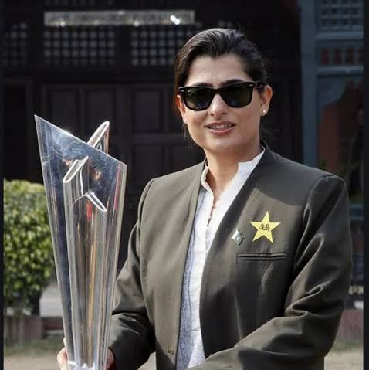
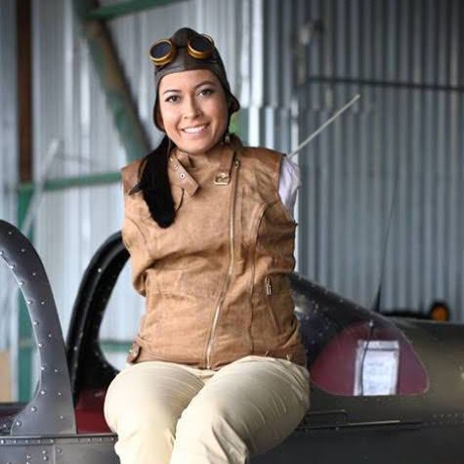
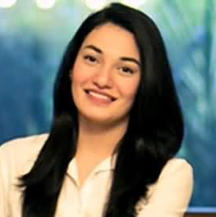
Inspirations
Sana Mir
She is a former Pakistani cricketer who served as a captain of the Pakistan national women's cricket team. In October 2018, she became the first Pakistani women cricketer to rank number 1 in ICC ODI bowler ranking. She has led Pakistan to two Gold medals in Asian Games 2010 and 2014.
Jessica Cox
She suffered a rare birth defect and was born without any limbs but with great spirit she became the first pilot with no arms. Also she is a double black belt in taekwondo and can do almost everything with her feet. She made me realize that a person can fly without wings.
Muniba Mazari
She is from a Baloch background, belonging to the tribe of Mazari. In 2008 she met an accident in which she sustained major injuries which left her lower body was paralyzed but none of this stopped her from being Pakistani activist. She became the National Ambassador for UN Women Pakistan. She also made it to the Forbes 30 list for 2016.
Many people have inspired me in my life because of their actions, their bravery, and their heart.

Slide 10
Favorite songs
Young stunners
Afsanay
Gumaan
Lewis Capaldi
Somebody you loved
May be
Marshmello
Happier
Wolves
Listening to music helps lessen the stress, pain, struggle, distraction and bring positivity and calmness in our daily life. Music can make us expressive and help us in understanding our feelings and emotions in a better manner.

Slide 11

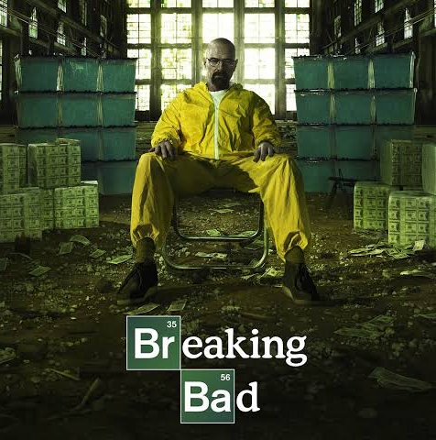




Favorite Movies and shows
Brooklyn nine-nine
Breaking Bad
Stranger Things
Movies allow us to explore our minds, to experience and feel things we wouldn't normally feel within the real world, to escape reality.
Harry Potter
Into the heart of the sea
The Conjuring

Slide 12
My motto in life
My motto in life has always been 'Everything happens for a reason. ' No matter what, good or bad, there is a reason for it all. Dream, believe, achieve. Live every day to the fullest
I believe everyone should be equal, and we should all love and support each other and express ourselves the way we want to express ourselves and be whoever we want.

Slide 13
Thank You

